Slide 1









pharma
gard
AI-POWERED PHARMACOGENOMIC RISK PREDICTION SYSTEM
RIFT 2026 Hackathon
Precision Medicine Through Explainable AI
BugByte

Slide 2









PROBLEM & OBJECTIVE
The Challenge
100,000+ deaths annually due to adverse drug reactions
Drug response varies due to genetic differences
Traditional prescriptions ignore genomic variability
Limited access to explainable genomic decision tools
Our Objective
Build an AI-powered system that:
Analyzes genetic VCF data
Predicts personalized drug risk
Generates clinically explainable recommendations

Slide 3









OUR SOLUTION
PharmaGuard is a web-based AI platform that:
Parses authentic VCF files
Detects variants in 6 critical pharmacogenomic genes
Predicts drug-specific risk (Safe, Adjust, Toxic, etc.)
Provides CPIC-aligned dosage recommendations
Generates explainable AI-driven clinical summaries
✔ Fast
✔ Scalable
✔ Clinically interpretable

Slide 4




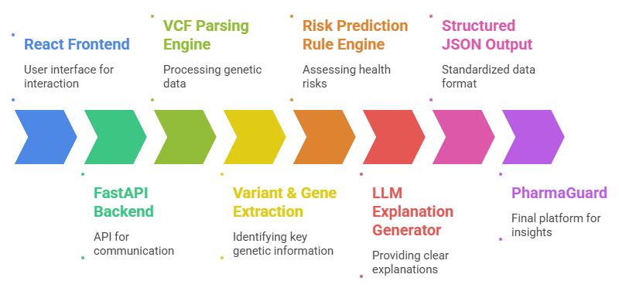




SYSTEM ARCHITECTURE & INTELLIGENCE

Slide 5















IMPACT & INNOVATION
Combines Genomics + AI + Explainability
CPIC-aligned recommenda-tions
Transparent decision logic
Structured clinical-grade output
Support AI-driven clinical decisions
Reduce adverse drug reactions
Enable safer personalized prescribing
Improve precision medicine outcomes
Thank you!

